Slide 1
Handling HTTP and WebSocket Protocol
Mykhailo Miroshnikov

Slide 2
Agenda
HTTP
require(‘http’)
Server
Request
Response
Static Server
Methods, Status Codes
Error handling
Client
HTTPS
HTTP/2
WebSocket Protocol

Slide 3
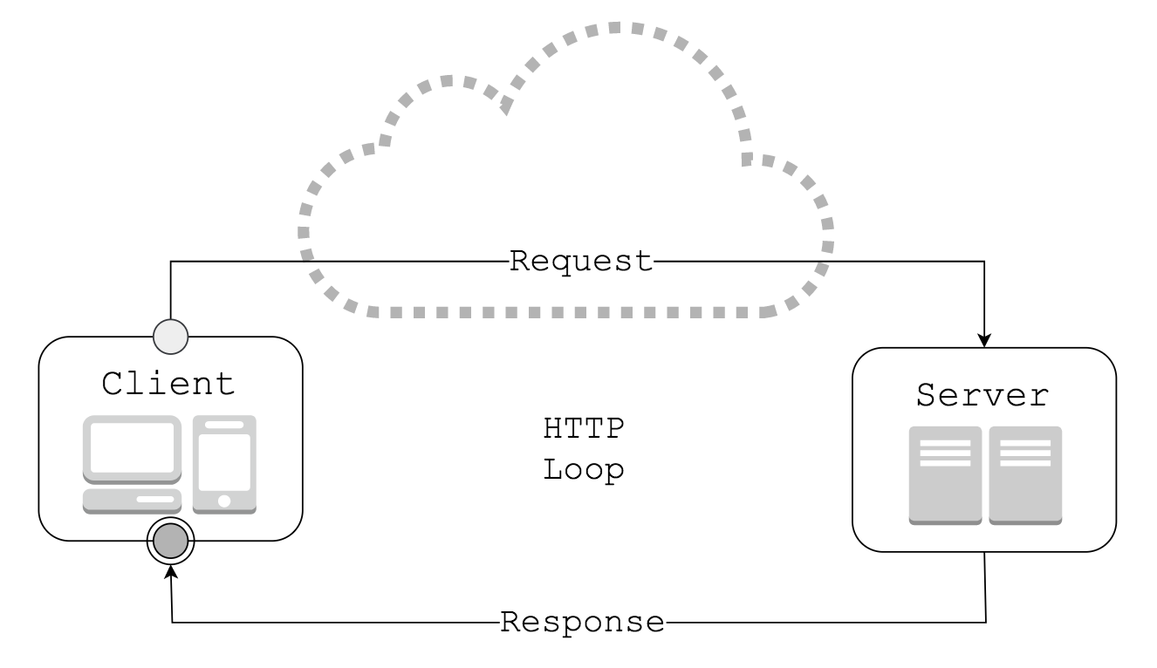
HTTP - Hypertext Transfer Protocol
Client - requests via Request
Server - responds via Response
Request and Response are almost identical in terms of structure
Client initiates communication

Slide 4
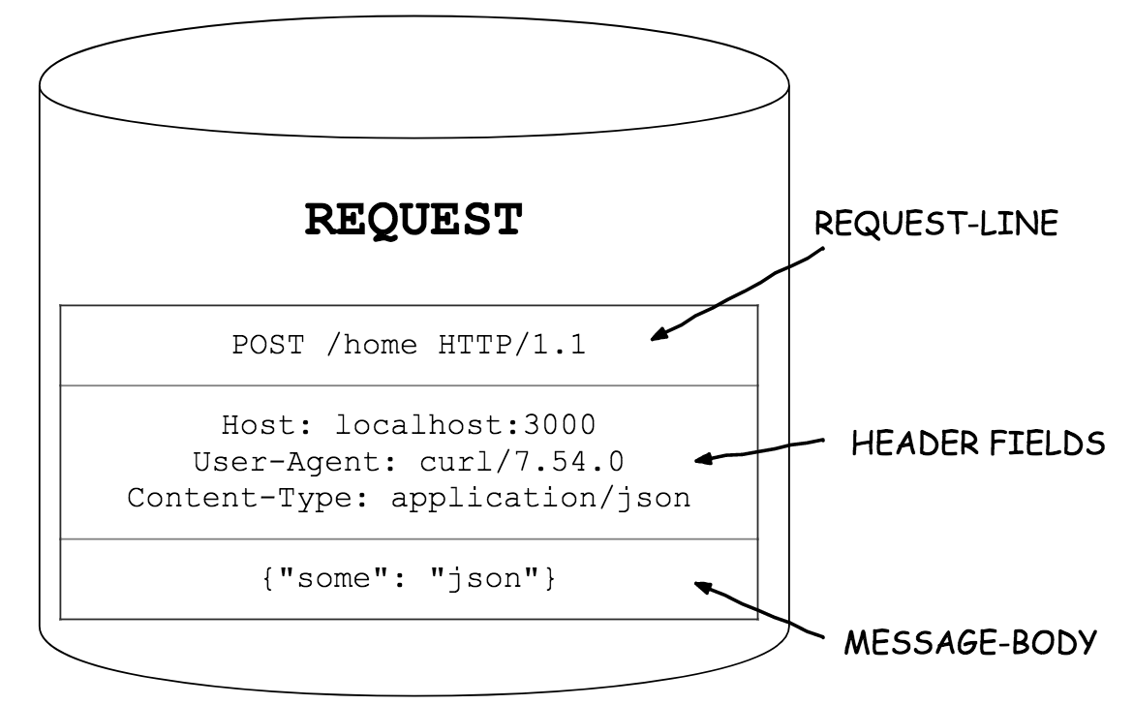
HTTP Request
Request-line
HTTP Method
URI
Protocol Version
Header Fields
Message-body

Slide 5
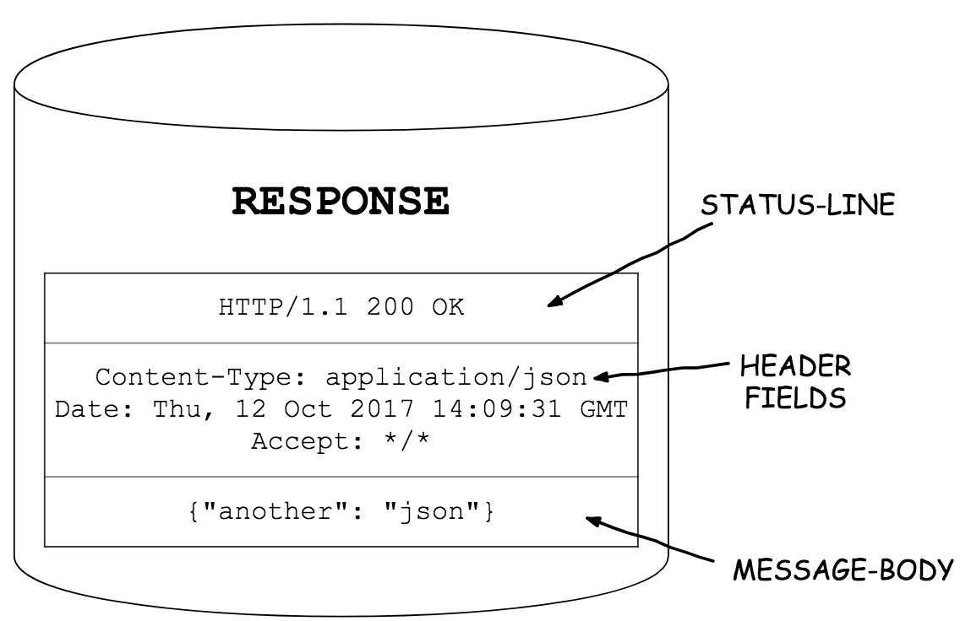
HTTP Response
Status-line
Protocol Version
Status Code
Reason Phrase
Header Fields
Message-body

Slide 6
require(‘http’) Members
Agent
ClientRequest
Server
createServer()
ServerResponse
IncomingMessage
METHODS
STATUS_CODES
get()
globalAgent
request()
require(‘http’)

Slide 7
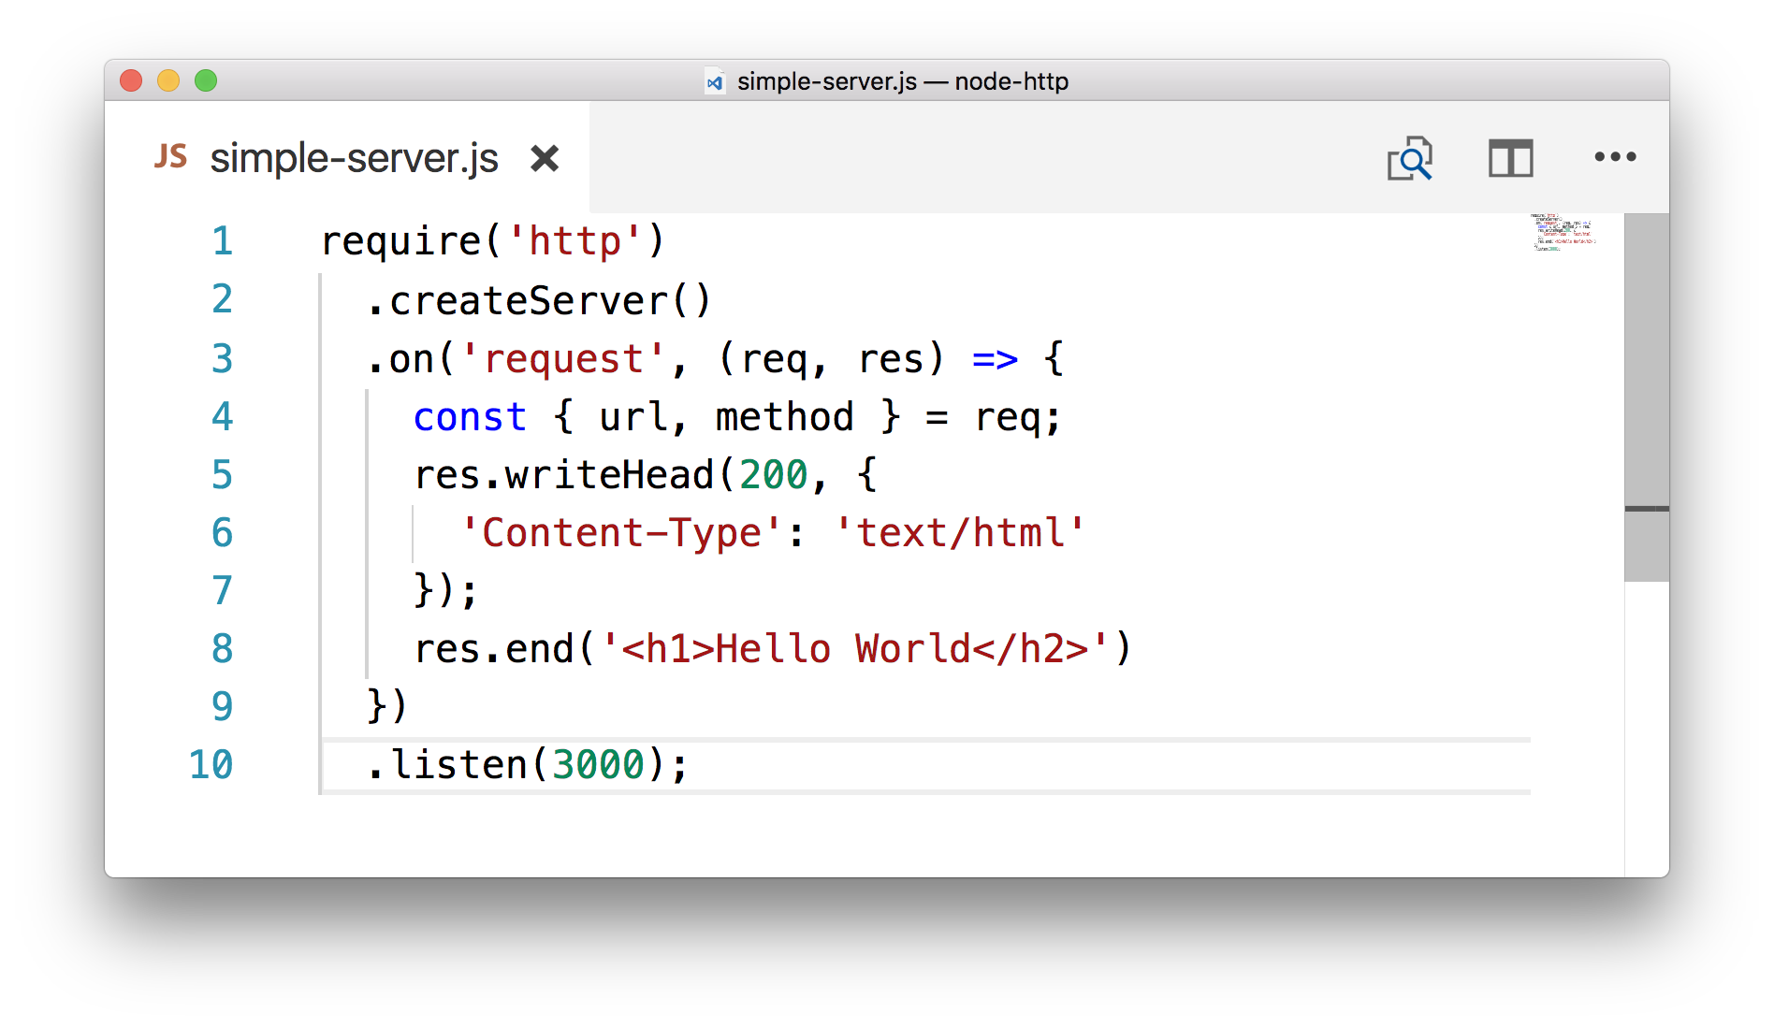
http.Server
http.createServer()
The cornerstone feature of Node.
Minimum setup:
Create an instance of Server
Attach request handler to it
Make it listen on port

Slide 8
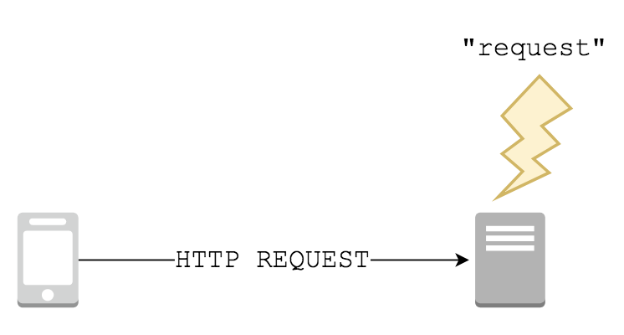
http.Server as EventEmitter
“request”
Emitted each time there is a request.
There can be multiple requests done over a single connection in case of Keep-Alive HTTP connection.
server.on(“request”, cb);

Slide 9
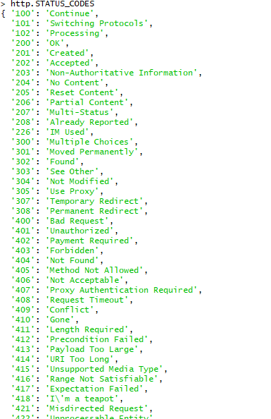
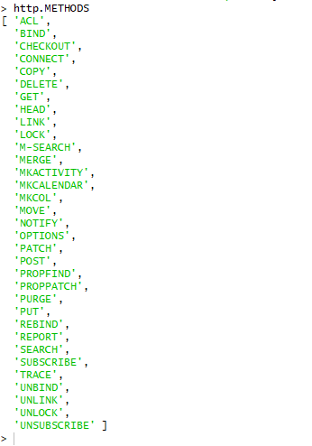
http.METHODS http.STATUS_CODES
Just a set of handy utility constants.

Slide 10
http.Server as EventEmitter
Event | Emitted when... | Useful when...
“checkContinue” | Expect: 100-continue header is received | Need to validate before receiving the body
“checkExpectation” | Expect header is received (but not 100-continue) | …never?
“clientError” | Client connection emits error event | Need to override default 400 Bad Request response
“close” | Server closes | Need to clean up
“connect” | Client requests CONNECT method | Need to handle CONNECT method, otherwise will close connection
“connection” | TCP stream is established | …never
“upgrade” | Upgrade header is received | Need to switch protocols

Slide 11

Hello World
new http.Server([requestHandler]) OR
http.createServer([requestHandler]);
OR
server.on(‘request’, requestHandler);

Slide 12
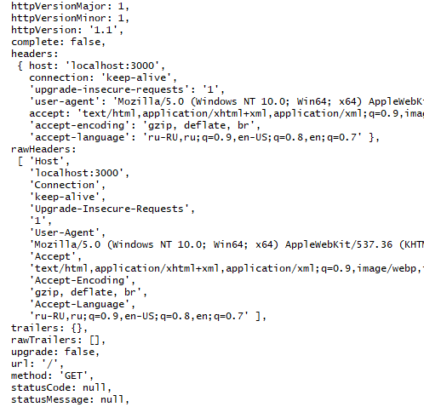
Reading from Request
Request contains lots of data.
Being a data stream, request body is not one of it’s fields.

Slide 13
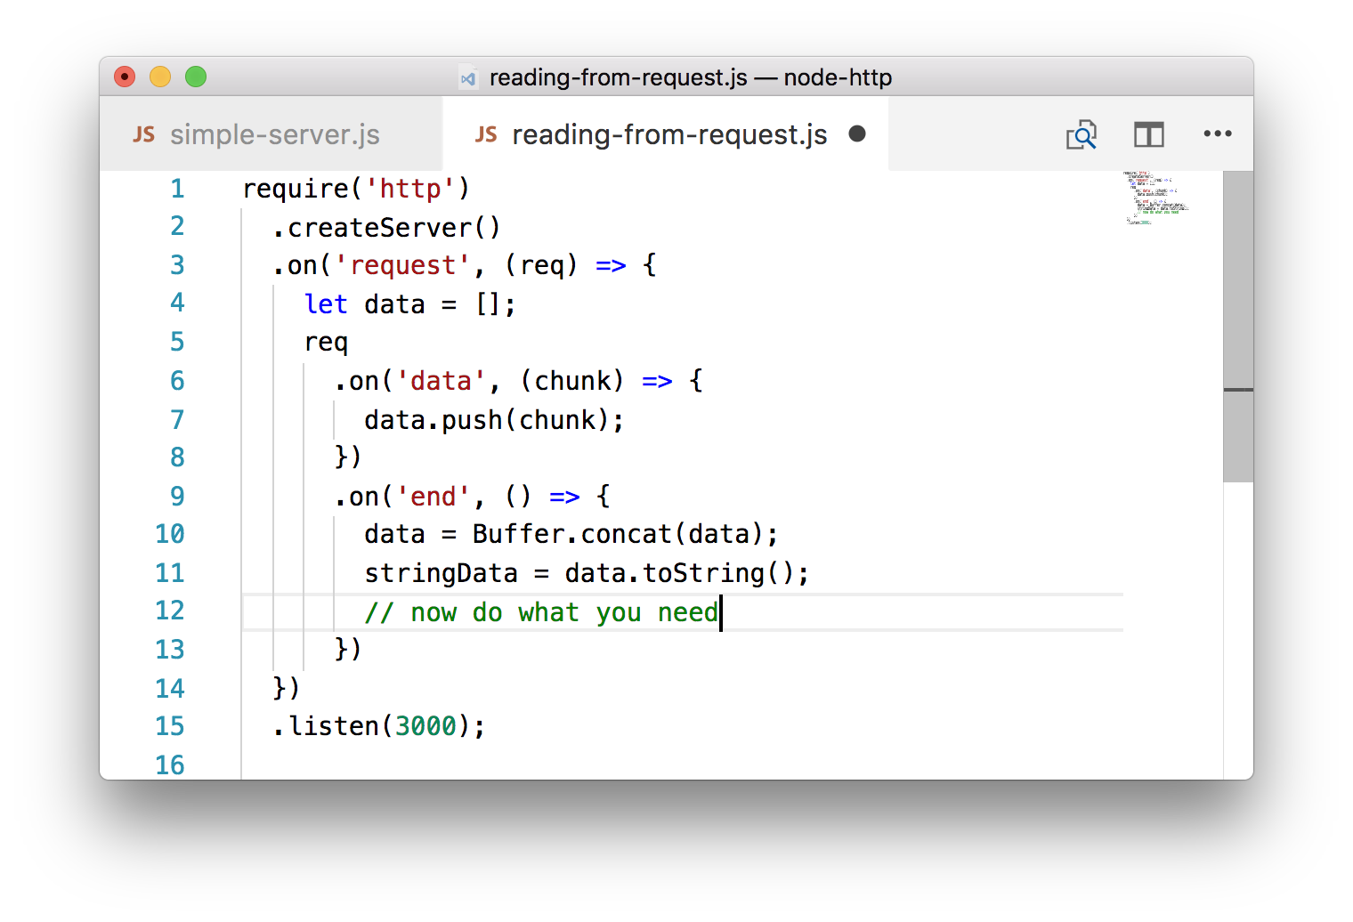
Reading from Request
Reading body
request is a Readable stream. In order to process request body, use its data and end events, as well as pipe() method in order to output data to a writable stream:
req.pipe(fs.createWriteStream(‘data.txt’))

Slide 14
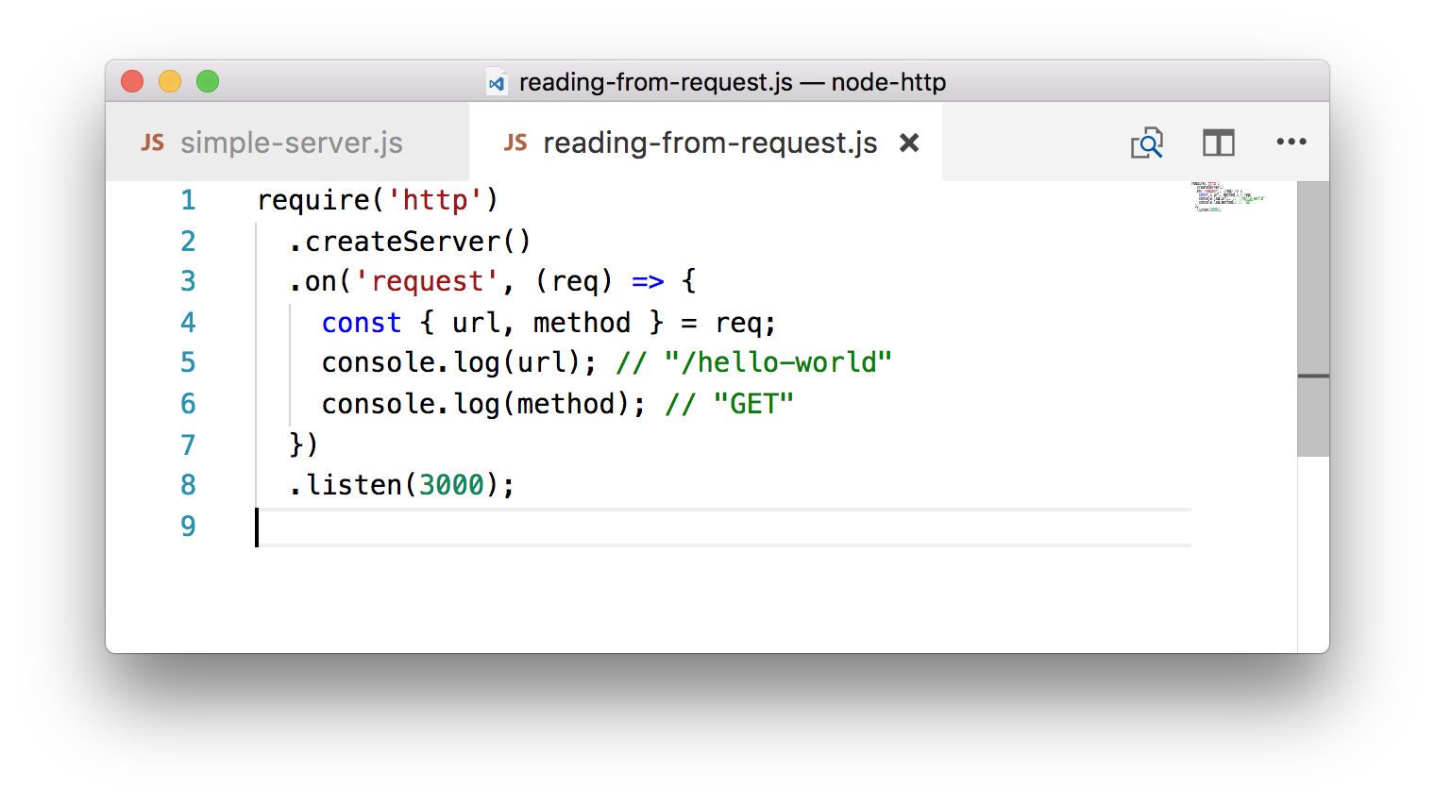
Reading from Request
Reading url and method
curl localhost:3000/hello-world

Slide 15
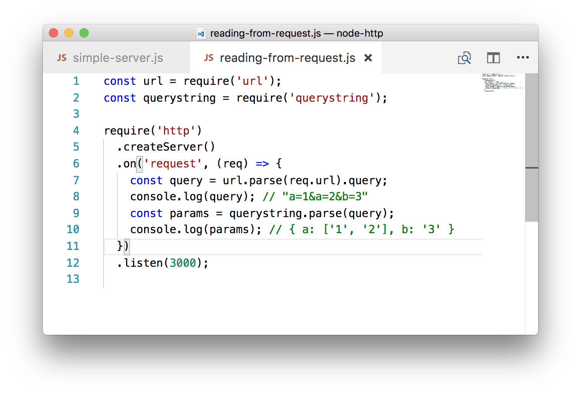
Reading from Request
Use require(‘querystring’)and require(‘url’) to parse query string params.
Parse req.url and extract query string
Parse query string and extract params

Slide 16
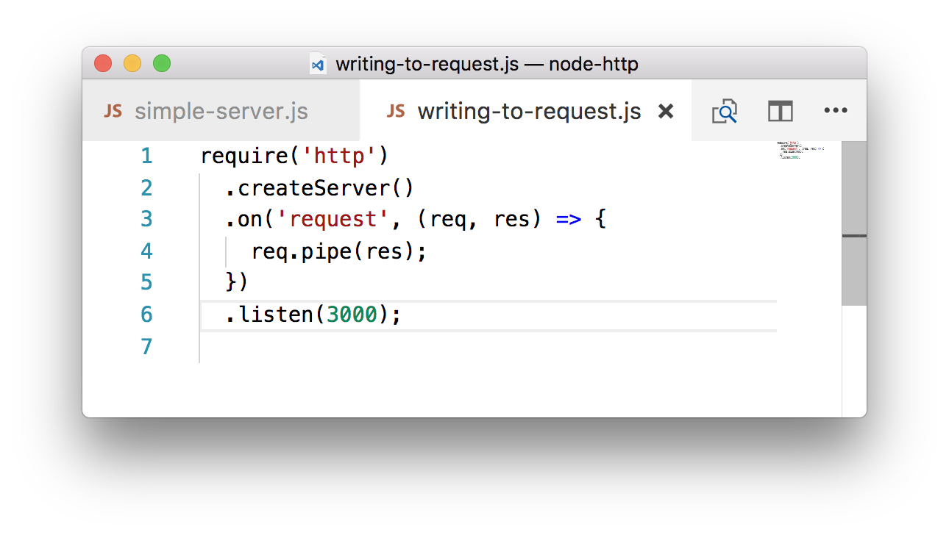
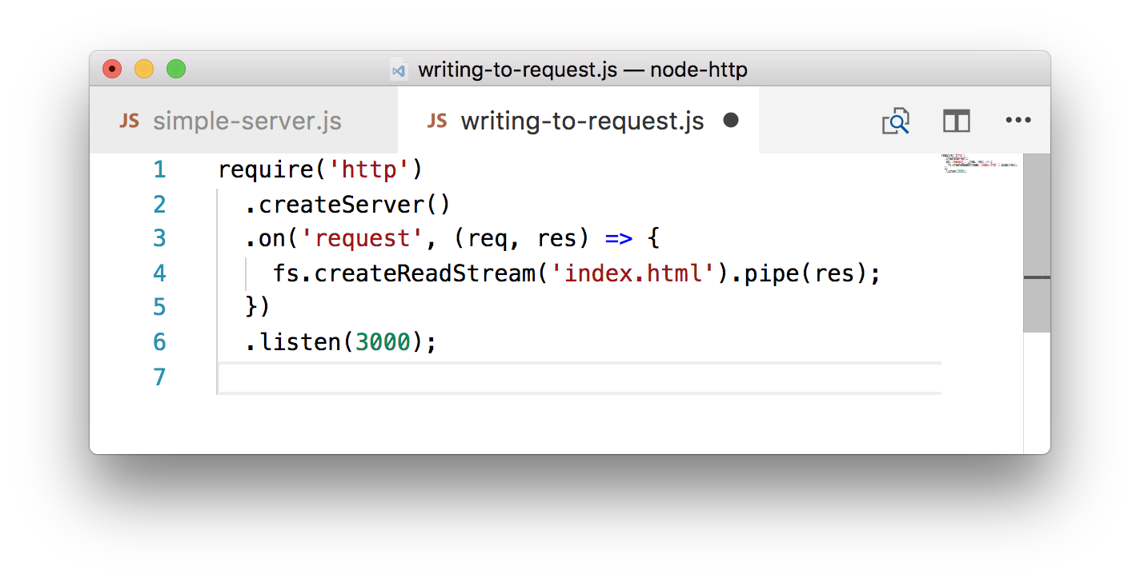
Writing to Response
response is a Writable stream
write() end() pipe()
Echo
Static

Slide 17
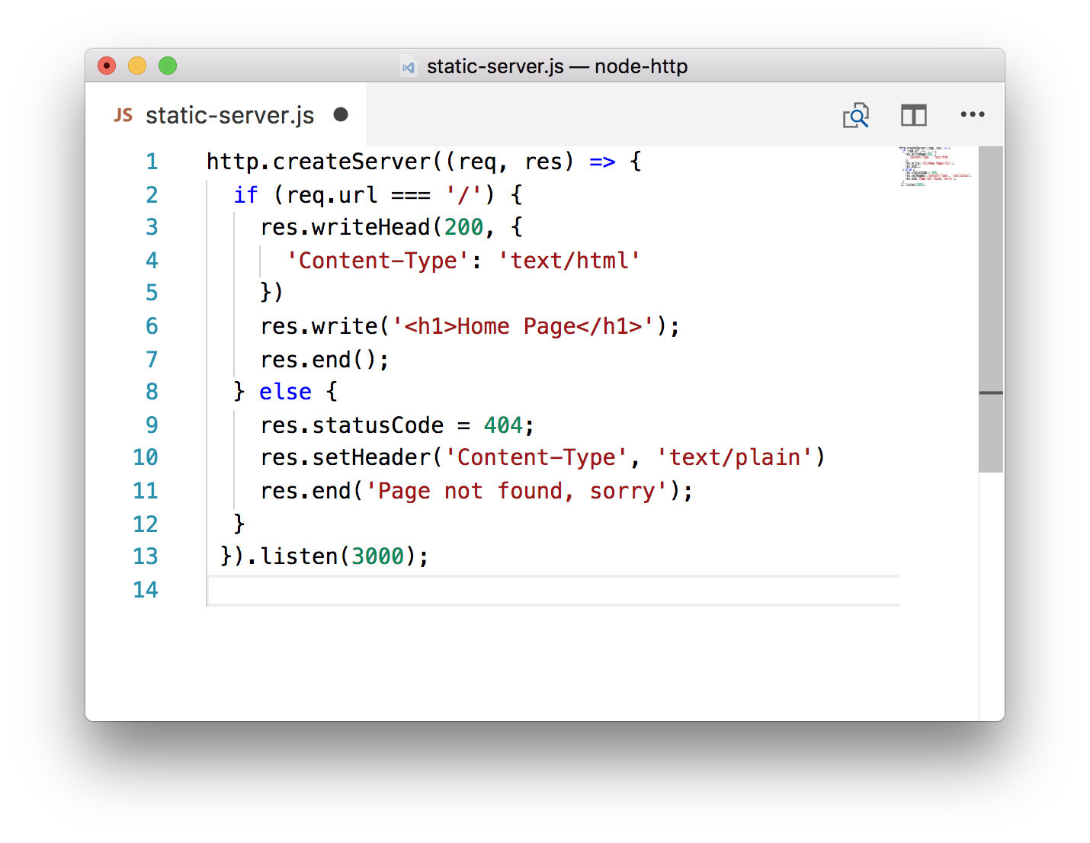
Writing to Response
Make sure to write headers before response.write() is called
res.statusCode + res.setHeader()
===
res.writeHead()

Slide 18
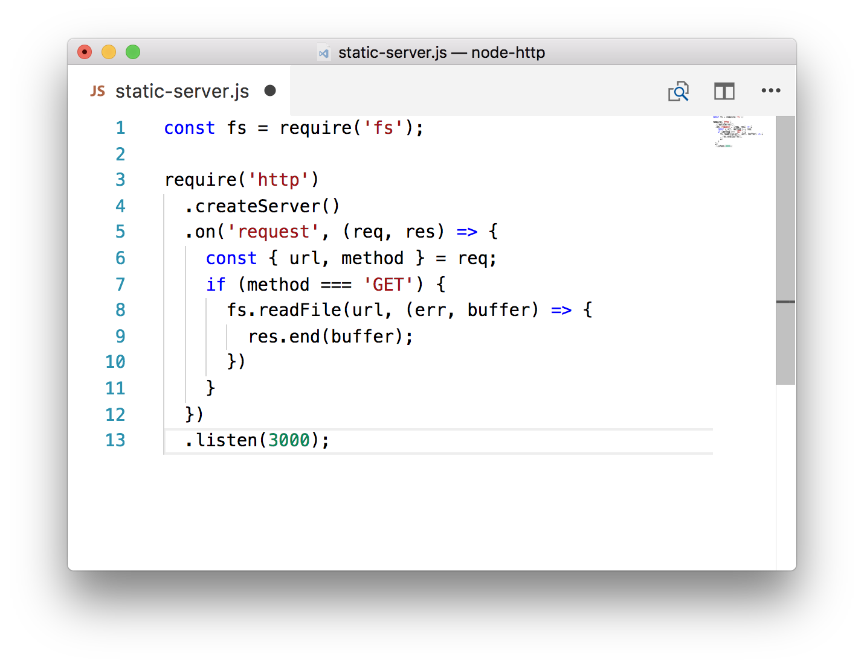
Static Server
Static server is aimed for serving static resources - i.e. files.
Problem: huge memory consumption
Solution: streaming files
This could be a disaster for large files, but it’s still 10000% better than fs.readFileSync()

Slide 19
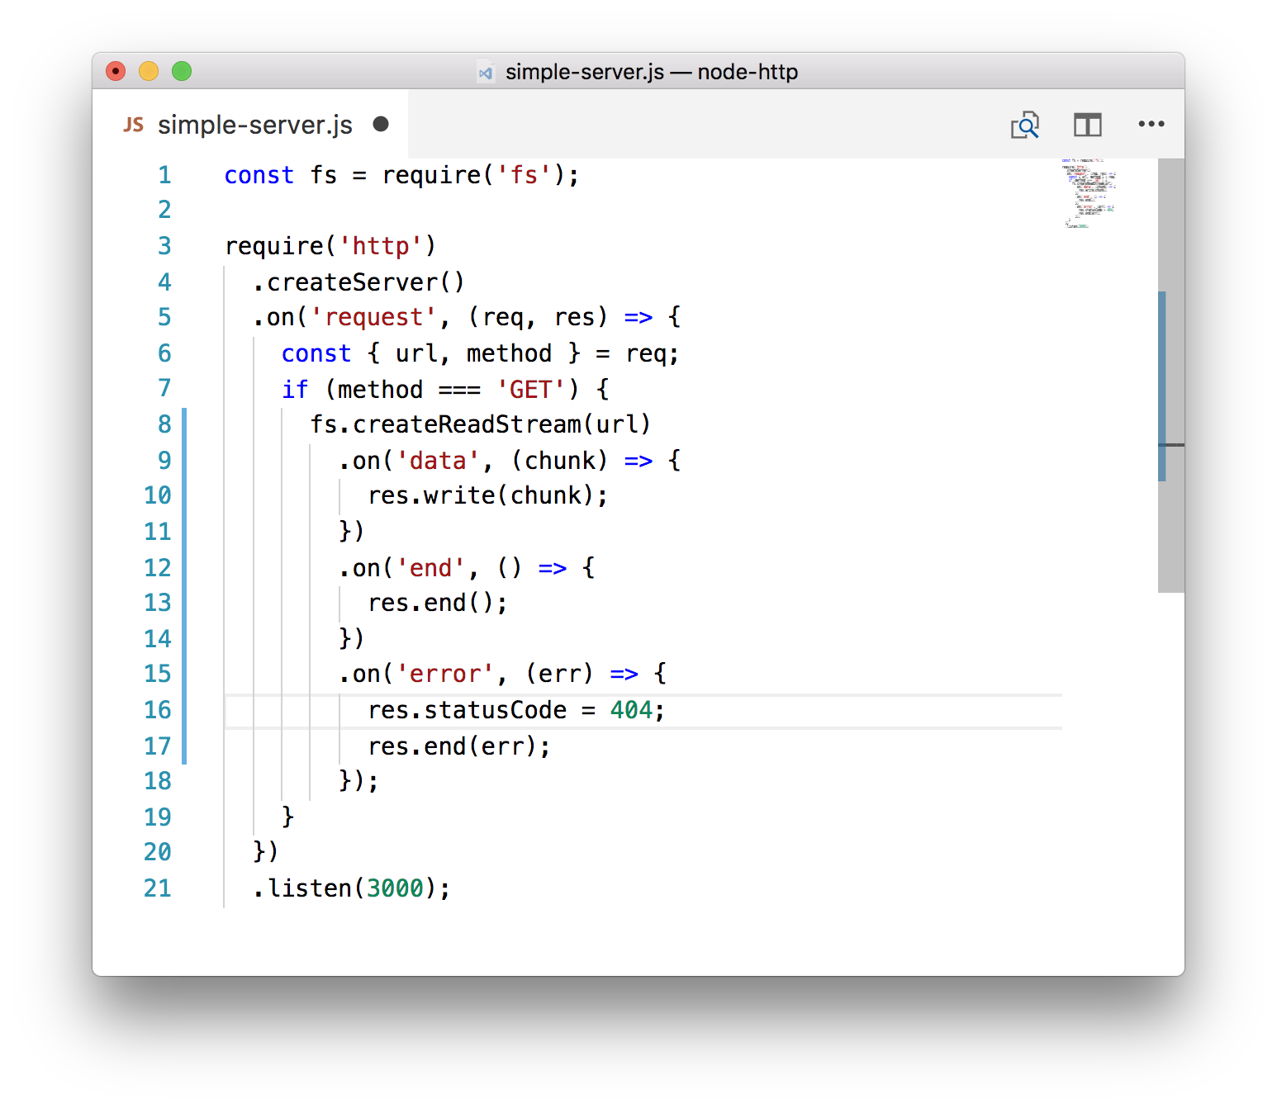
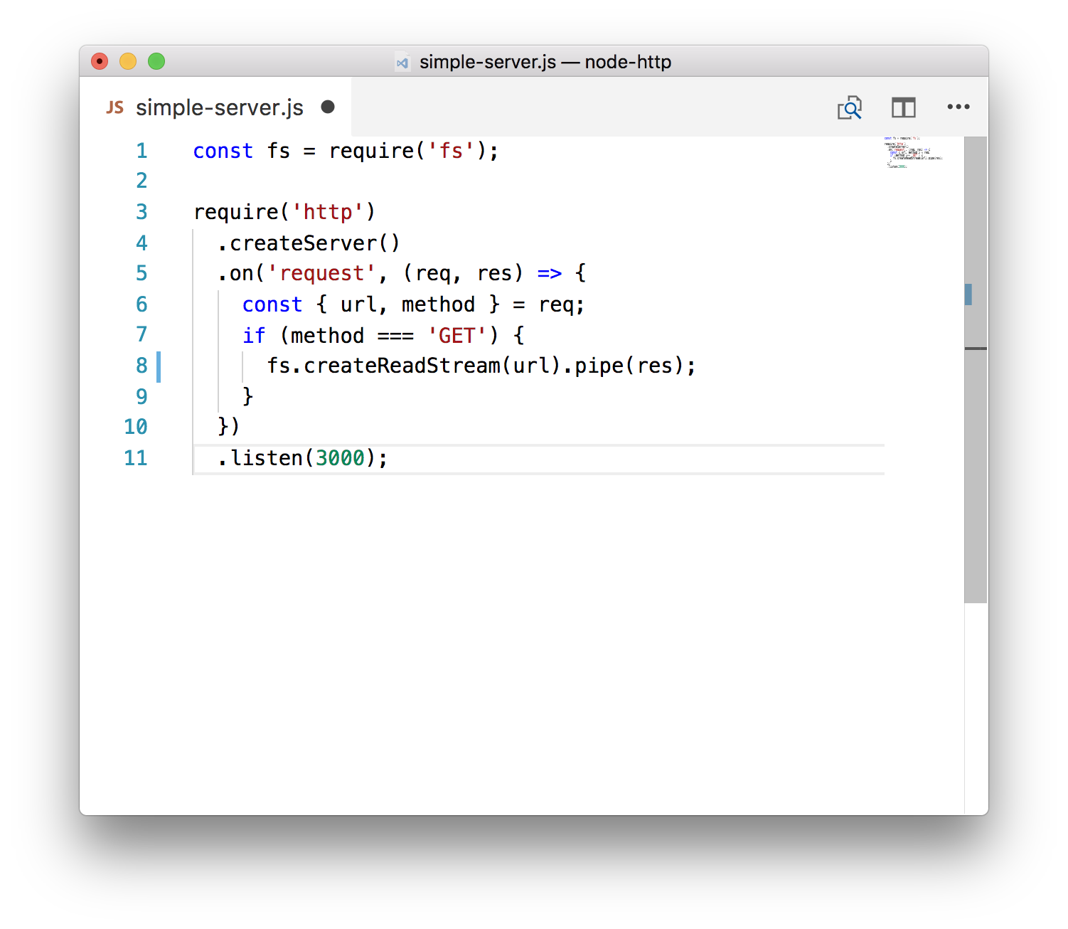
Static Server on Stream
Good
Better (remember to add Content-Type header!)

Slide 20
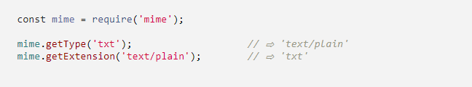
Static Server: Content-Type
In order to set proper mime-types, use npm i mime package.

Slide 21
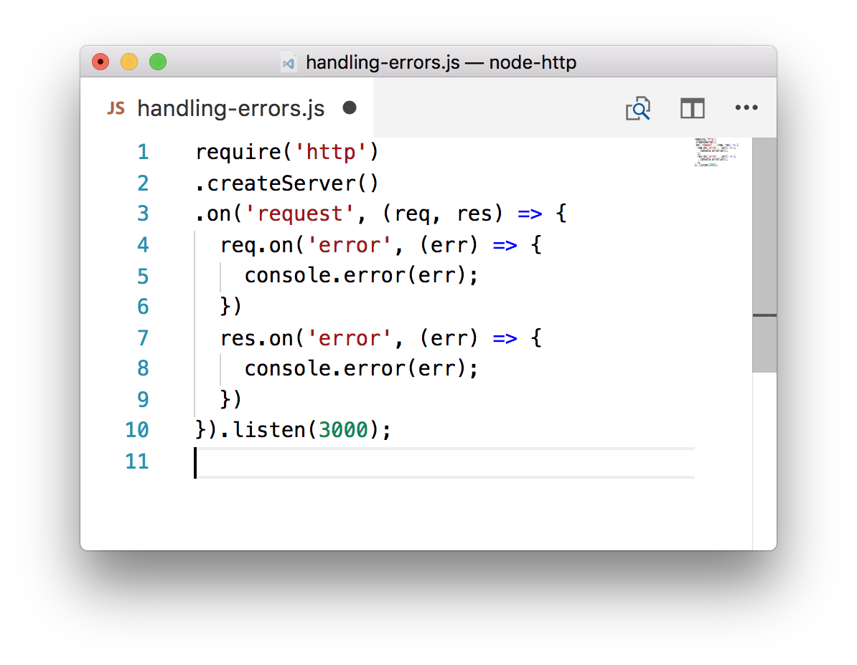
Error Handling in Request Response
If unhandled, errors will throw and down your server.
Handle error event for both req and res.
Marvelous error handling guide: link

Slide 22
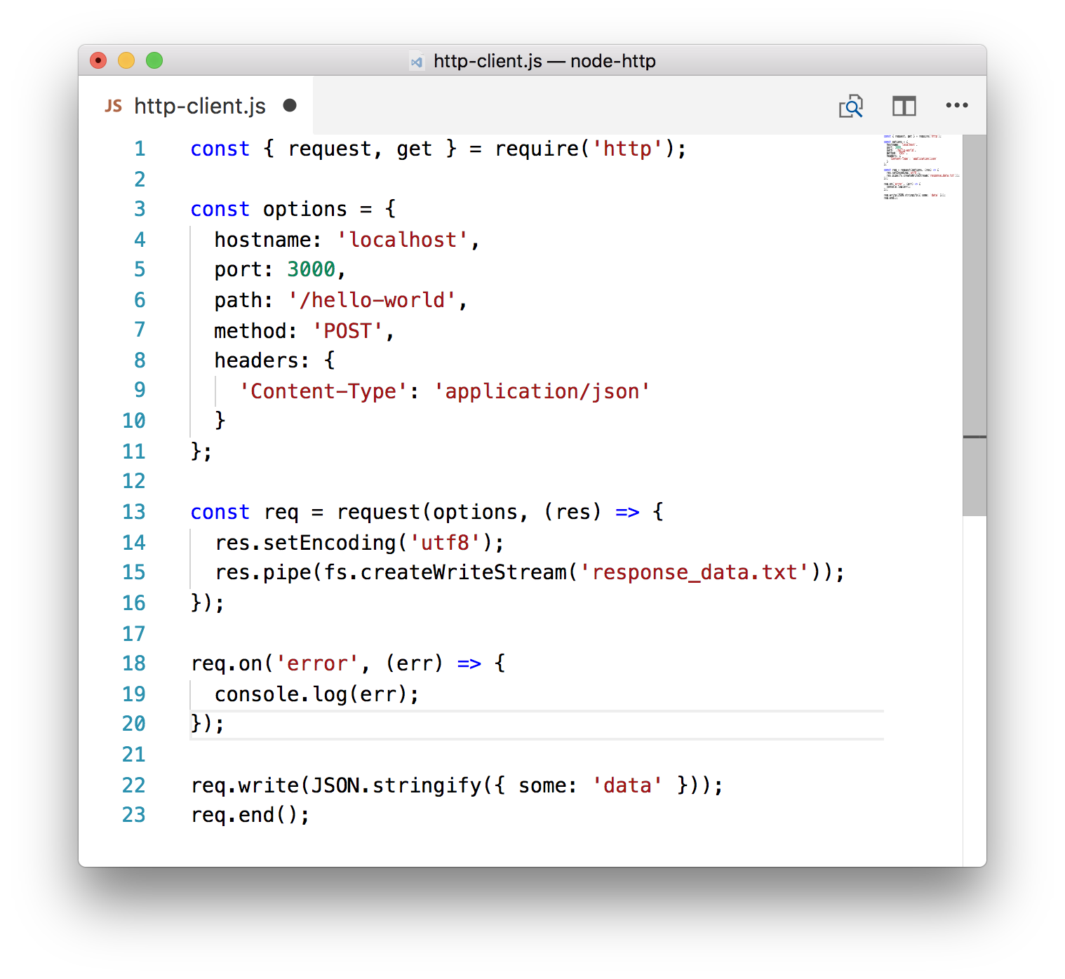
HTTP Client
Use http.request()
request is a Writable stream
response is a Readable stream
use http.get() as a shortcut for GET requests
DO NOT request() endpoints set up on the same node.js process

Slide 23
HTTPS SSL Certificate
Issue CSR (certificate signing request) and private key: openssl req -new -newkey rsa:2048 -nodes -out mydomain.csr -keyout private.key
THEN
Use CSR to generate your SSL Certificates (primary and intermediate) from issuing authority.
THEN
Run your HTTPS NodeJS server. (and remember to redirect HTTP traffic to your HTTPS server)

Slide 24
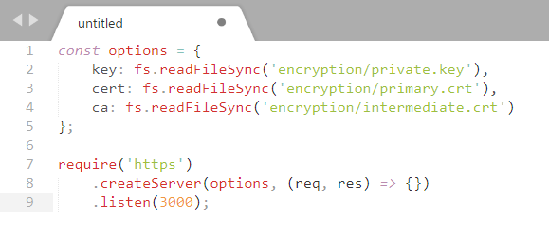
require(‘https’)
Running HTTPS Server:

Slide 25
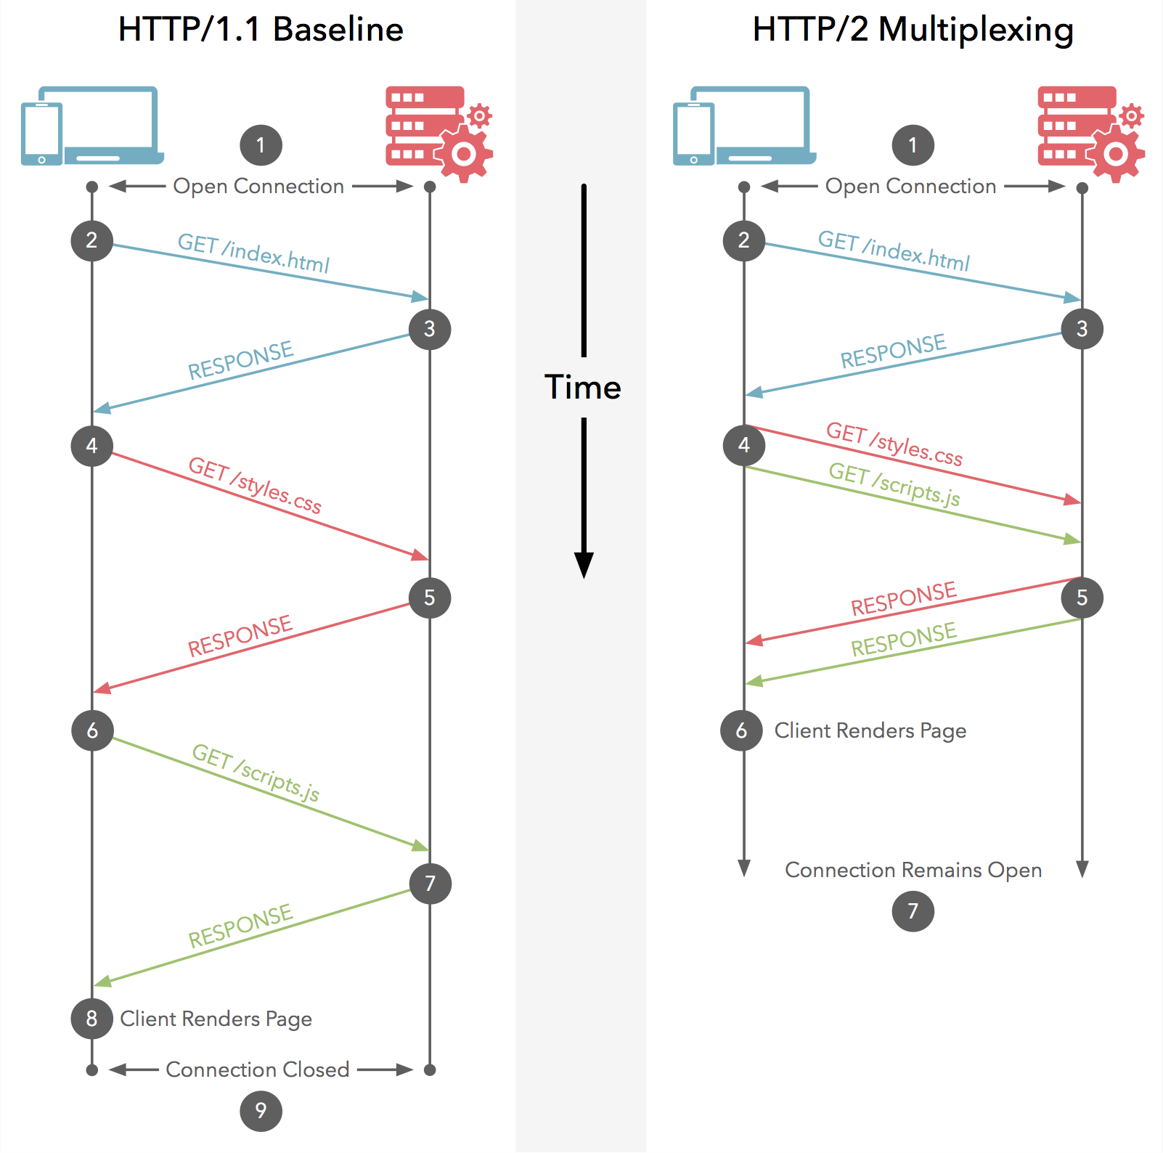
HTTP/2
Motivation:
More efficient use of network resources and reduced perception of latency
How?
Header field compression
Multiple concurrent exchanges on the same connection (multiplexing)
Allow servers to “push” responses proactively into client caches
Binary over textual
Single TCP connection

Slide 26
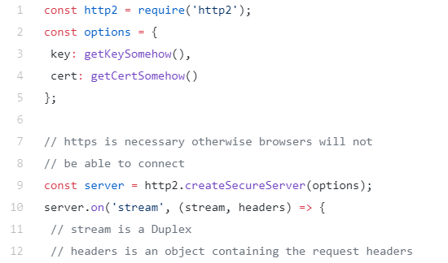
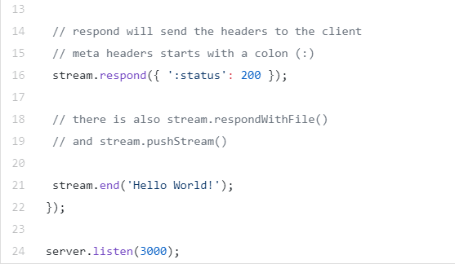
HTTP/2 Server: Hello World

Slide 27
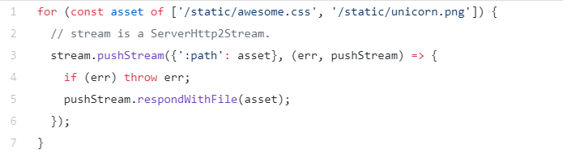
HTTP/2 Server: Push
Push assets by creating new streams of data:

Slide 28
HTTP/2 Reading
Reading:
HTTP/2 Spec https://http2.github.io/http2-spec/
Node API https://nodejs.org/api/http2.html
HTTP/2 FAQ https://http2.github.io/faq
HTTP/2 Guide

Slide 29
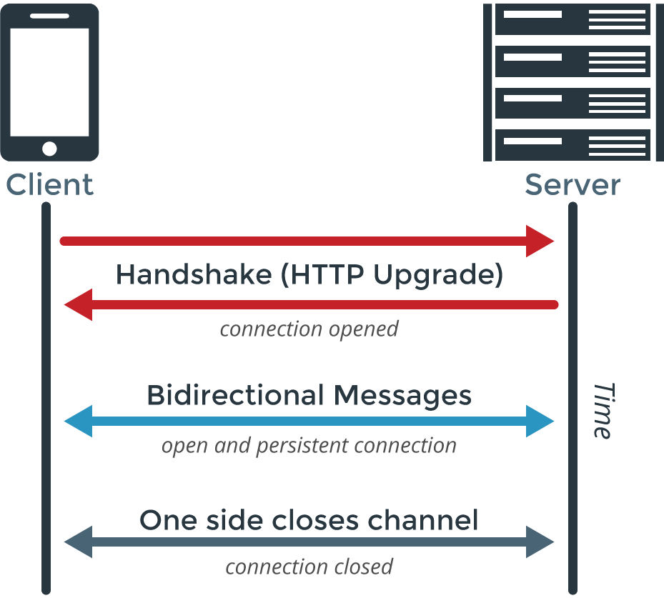
WebSocket Protocol
WebSocket is a computer communications protocol, providing full-duplex communication channels over a single TCP connection.
Spec https://tools.ietf.org/html/rfc6455

Slide 30
WebSocket Handshake
Handshake Request from the Client:
GET /chat HTTP/1.1 Host: server.example.com Upgrade: websocket Connection: Upgrade Sec-WebSocket-Key: dGhlIHNhbXBsZSBub25jZQ== Origin: http://example.com Sec-WebSocket-Protocol: chat, superchat Sec-WebSocket-Version: 13
Handshake Response from the Server:
HTTP/1.1 101 Switching Protocols Upgrade: websocket Connection: Upgrade Sec-WebSocket-Accept: s3pPLMBiTxaQ9kYGzzhZRbK+xOo= Sec-WebSocket-Protocol: chat
When handshake is complete, data transfer part starts (UTF8 or Binary)

Slide 31







Existing WebSocket Libraries
Library | Comments | Stars
ws | One of the fastest WebSocket server and client for Node
websocket-node | WebSocket server and client for Node
socket.io | WebSocket server and client for Node + client for browsers + channels + fallbacks
sockjs | WebSocket server and client for Node and others + client for browsers + fallbacks
faye | WebSocket server and client for Node and others + client for browsers + fallbacks
And many others: link

Slide 32
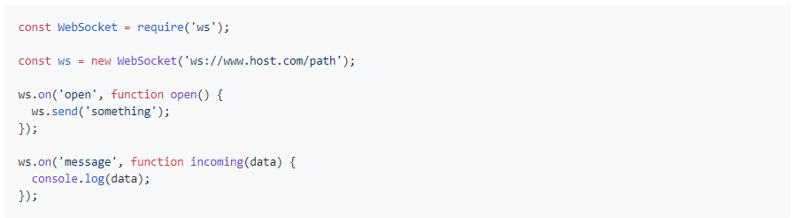
npm install ws: Sending Text Data

Slide 33
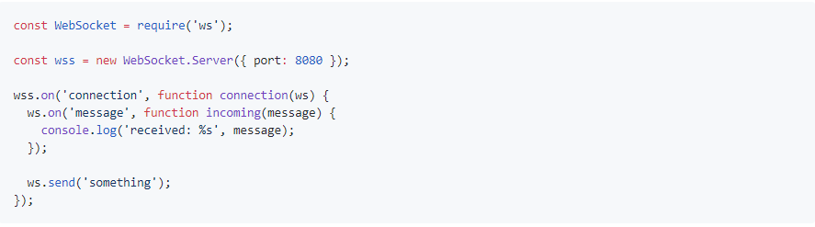
npm install ws: Simple Server

Slide 34
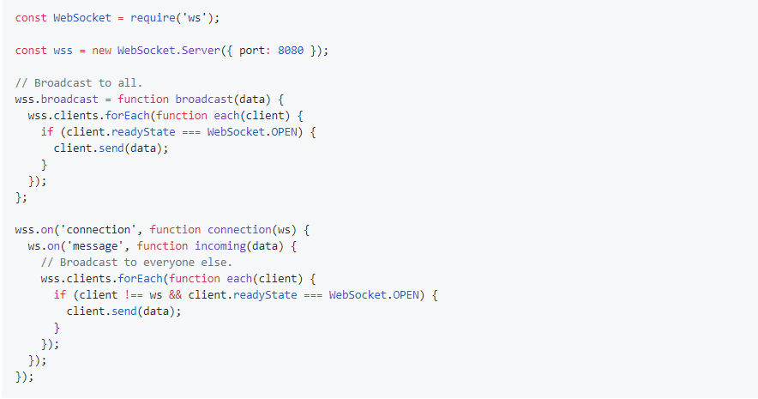
npm install ws: Server Broadcast

Slide 35
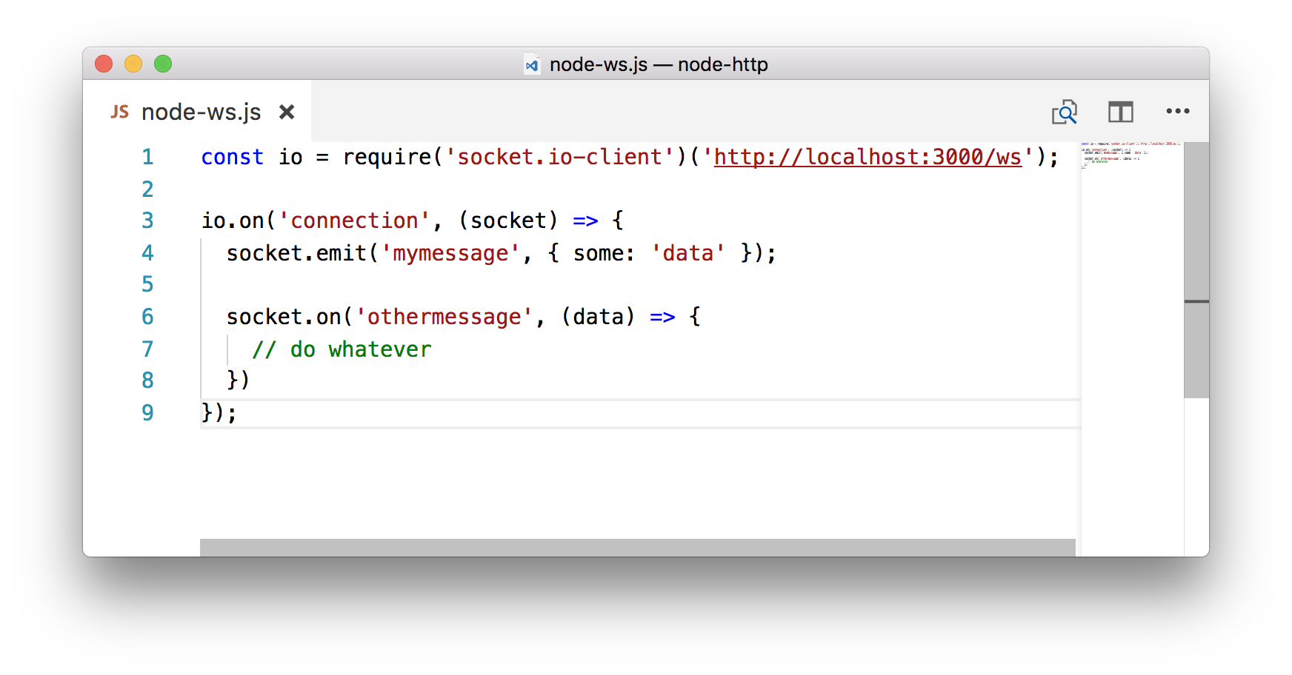
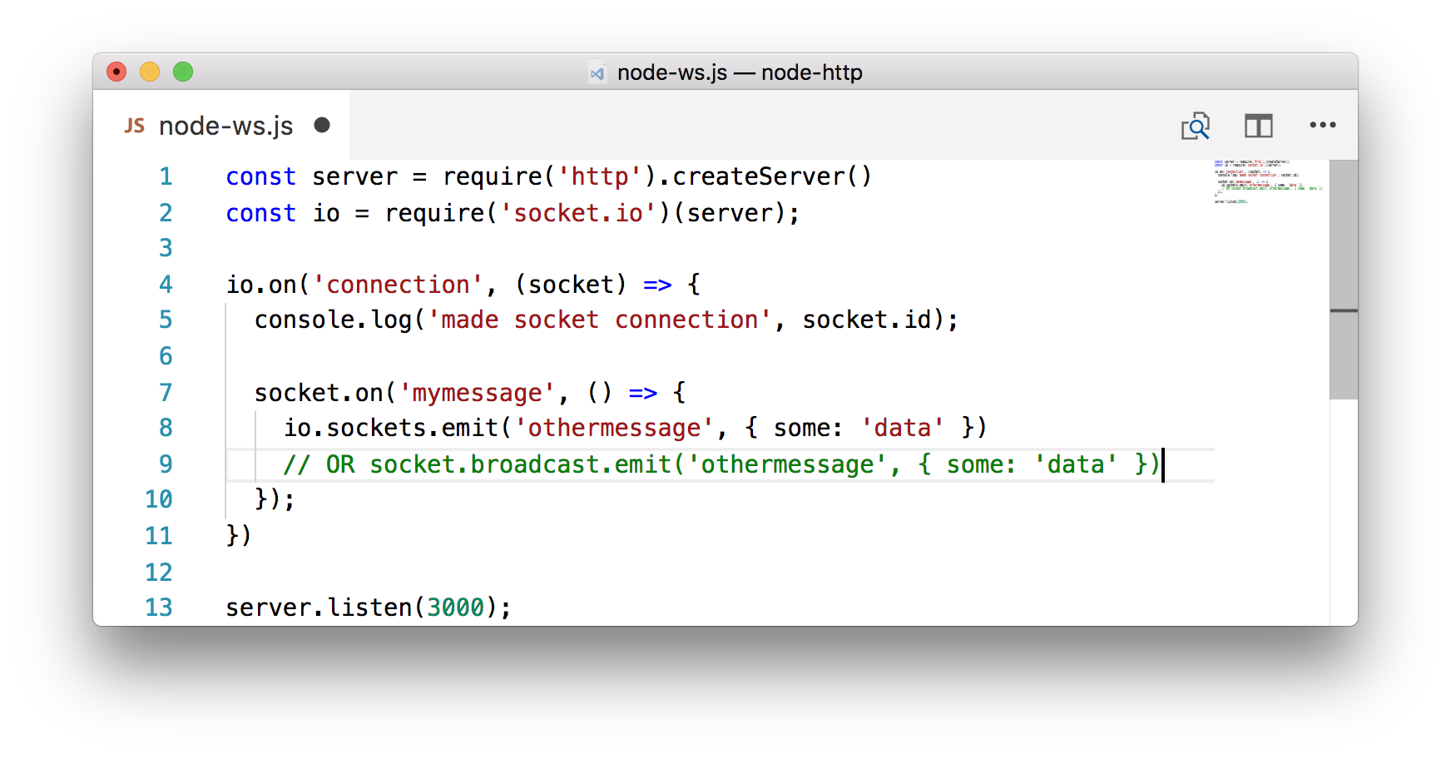
socket.io Example
Client
Server

Slide 36
WebSocket Summary
WebSocket is a bidirectional communication protocol
There are various Server and Client implementations for JavaScript, but not all include browser implementation for Client.
Both textual and binary data can be sent over WebSocket
Connection can be closed from both - server and client - sides

Slide 37

Questions?

Slide 38
Thanks

